Slide 1
RAIL MARKETING AND PUBLIC ENGAGEMENT
RAIL NEWCASTLE CONFERENCE 2015
01.11.2012, Hamm
Trevor Garrod // EUROPEAN PASSENGERS‘ FEDERATION // www.epf.eu

Slide 2
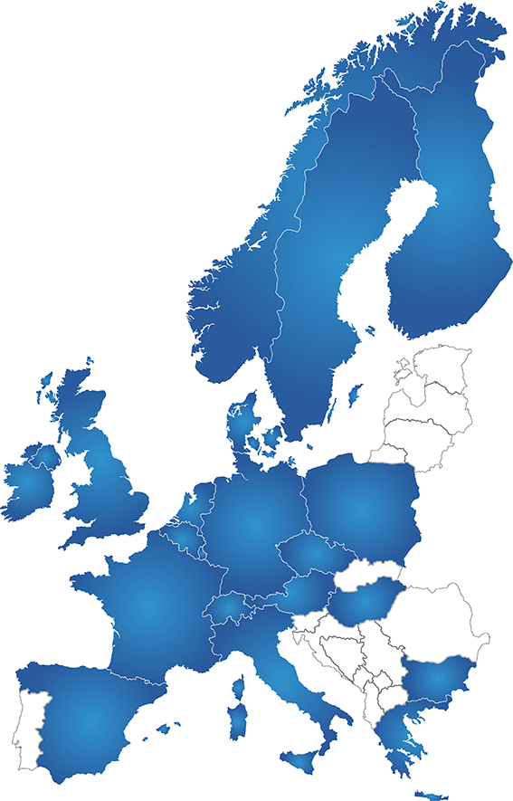
EPF MAP July 2015
34 member organisations
20 countries

Slide 3
WHAT IS THE EUROPEAN PASSENGERS ‘ FEDERATION?
founded 2002
the European umbrella organisation of national and regional passengers’ organisations
financed by its member organisations
representing passengers’ views at the European level
dealing with all modes of public transport such us local transport, railways, buses, aviation and maritime transport

Slide 4
A BIGGER ROLE FOR RAIL AND OTHER PUBLIC TRANSPORT
To fulfil the aims of the EU 2011 Transport White Paper
Modal shift to good quality public transport
Investment to expand and upgrade capacity
Most medium-distance traffic on rail by 2050
To encourage more people to use environmentally friendly transport
To integrate such transport modes

Slide 5
Value for money?
easy information
reliable information
easy ticketing door to door
transparent price system
comfort
convenience

Slide 6
Customer satisfaction
measuring satisfaction
by operators ‘own survey
statutary survey such as National Passenger Survey in Great Britain
surveys by passenger organisations such as Railfuture

Slide 7
Listening to your (potential) customers
Dialogue with statutory or voluntary consumer bodies
Local authorities
Interest groups
A role for social media
Would-be franchisees consult with stakeholders
Customers may promote rail and public transport if they are satisfied with the service
informally to family, friends, colleagues
through mass media and social media

Slide 8
Marketing in the widest sense
not just advertising to a captive audience on train or station
stands at events
articles in publications
websites and blogs
train operators sponsor events (e.g. Norfolk & Norwich Festival)

Slide 9
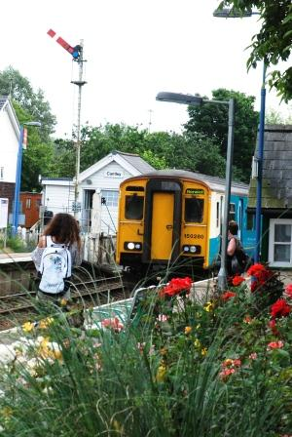
COMMUNITY RAIL PARTNERSHIPS local councils, operators, businesses
Source: ACORP
to promote regional services in Great Britain
First one formed in 1993; now over 50
Produce brochures, leaflets etc. (e.g. Discover the Blyth Valley”
Discounts at businesses /attractions for train and bus users (e.g. Beccles Lido)
Association of Community Rail Partnerships www.acorp.uk.com

Slide 10
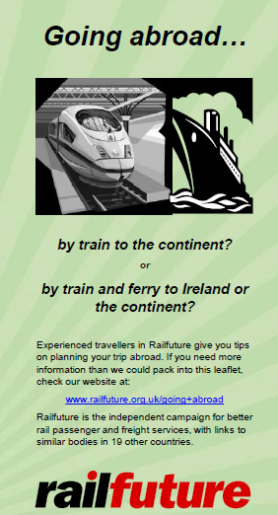
Role of passengers’ organisations
producing and distributing their own timetables, leaflets, posters, merchandise to fill gaps in the market.
their magazines and journals - paper and electronic – also prompt journalists to do stories
Railfuture’s “Going Abroad” leaflet
Promoting international travel
Discussing publicity with, for example, Interrail
Signposting members and the wider public on where to find travel and other information useful to rail passengers.

Slide 11
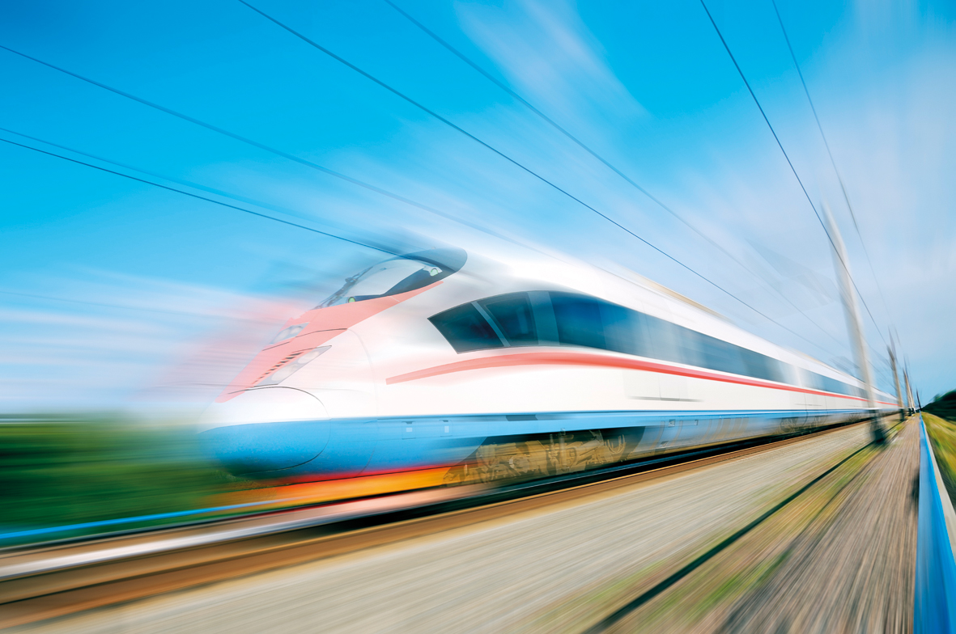
Thank you for your attention!
trevor.garrod@epf.eu

