Slide 1
DOUBLING COLLECTIVE LAND TRANSPORT – HOW TO ENCOURAGE IT
EUROPEAN CITIZENS‘ MOBILITY FORUM
2015, September 17th
01.11.2012, Hamm
Trevor Garrod // EUROPEAN PASSENGERS‘ FEDERATION // www.epf.eu

Slide 2
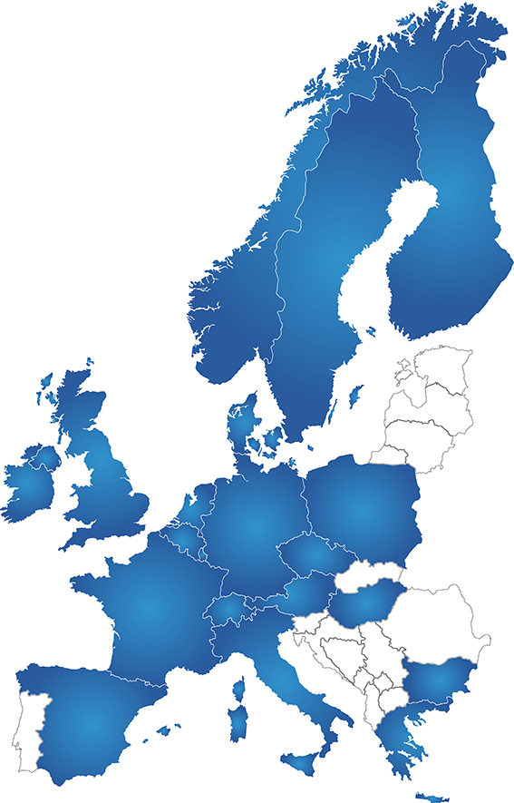
EPF MAP December 2014
34 member organisations
20 countries

Slide 3
WHAT IS THE EUROPEAN PASSENGERS FEDERATION?
founded 2002
the European umbrella organisation of national and regional passengers’ organisations
dealing with all modes of public transport such us local transport, railways, buses, aviation and maritime transport
aims to see environmentally friendly transport gaing greater market share

Slide 4
ENCOURAGING MODAL SHIFT THROUGH CHOICE AND EASE
Informed choice between speed and cheapness
Passengers need to know what to expect
Multimodal interchanges – accessible to all
Journey chain should be easy to research, plan and book
Operators must have a Plan B if things go wrong.

Slide 5
< HORSES FOR COURSES> Choose the most suitable means for YOU
Example: on July 6th three Englishmen went to a meeting in Utrecht, using different modes of transport:
SIMON went by coach Norwich – London; London – Rotterdam; then train
DONALD took 4 trains, Birmingham – London; London - Brussels; Brussels – Rotterdam; Rotterdam – Utrecht
TREVOR went rail/sea/rail - on one ticket!

Slide 6
NOT ALL TRAVELLERS ARE THE SAME
Experienced travellers usually know what to do, how to find out, how to book.
The less experienced need independent advice and/or a comprehensive journey-planner, giving a reasonable choice.
It is the less experienced who must be persuaded to use public transport if we are to achieve real modal shift.

Slide 7
HELP THEM ON THEIR WAY…
Transparent, simple pricing. No hidden extras!
Multimodal hubs (Not a car park on the edge of town or a back street)
Accessibility for PRMs – from which everyone benefits
Clear real-time information about onward journeys or delays
Seamless through ticketing where possible (e.g. British PlusBus; or multimodal zonal tickets)

Slide 8
KOCH REPORT ON MULTIMODAL INFORMATION AND BOOKING SYSTEMS
We in EPF welcomed this report which the European Parliament accepted in the summer.
We are doing our own survey of good and bad practice in multimodal ticketing, especially for international journeys.
Watch this space!

Slide 9
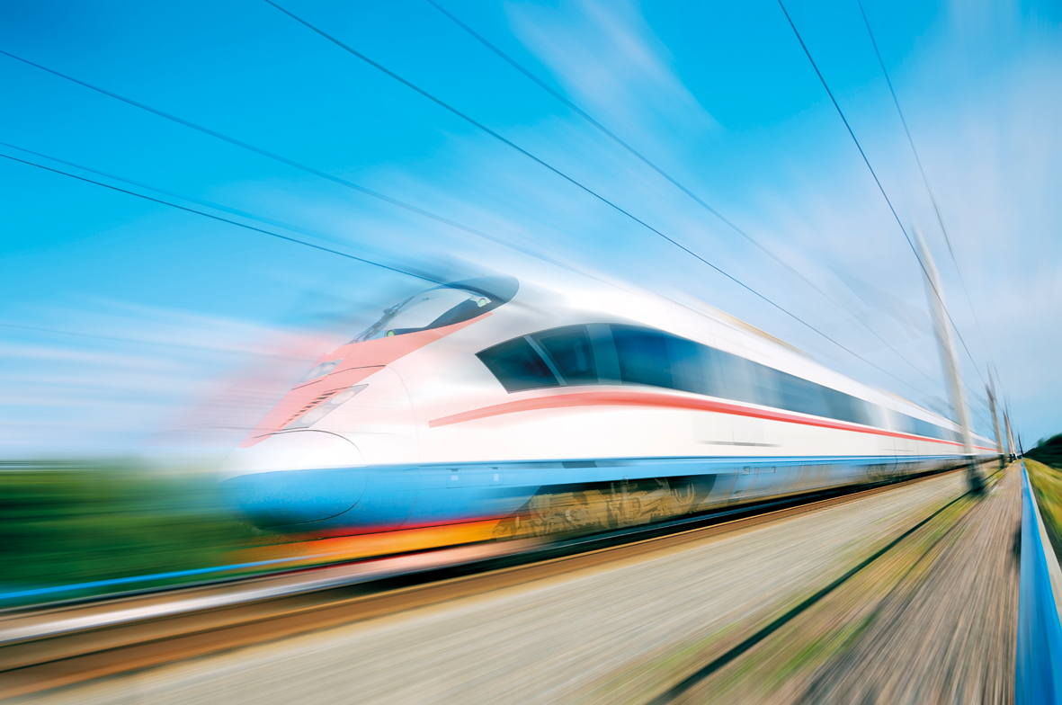
Thank you for your attention!
www.epf.eu

