Slide 1
The provision of EU-wide MULTIMODAL TRAVEL INFORMATION SERVICES
Passengers needs in information and ticketing
03.11.2015 Brussels
Josef Schneider // EUROPEAN PASSENGERS‘ FEDERATION // www.epf.eu

Slide 2
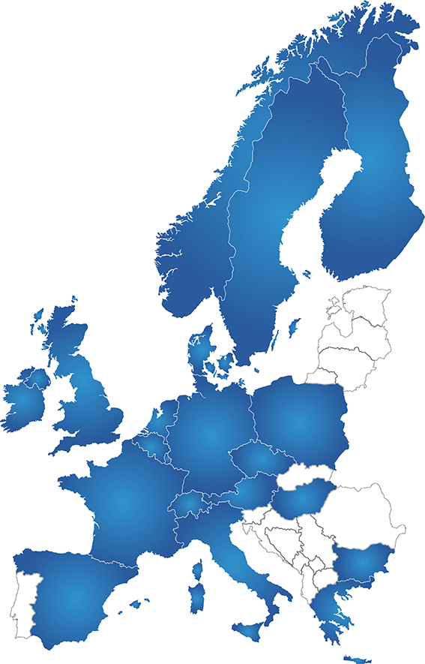
EPF MAP December 2014
35 member organisations
20 countries

Slide 3
WHAT IS THE EUROPEAN PASSENGERS’ FEDERATION?
founded 2002
the European umbrella organisation of national and regional passengers’ organisations
financed by its member organisations
representing passengers’ views at the European level
dealing with all modes of public transport such as local transport, railways, buses, aviation and maritime transport

Slide 4
Current situation
Privat car is the bench march in terms of easy using, navigation systems give you a full range of information
multi-modal information is available mostly on local and regional public transport level
gap of information even in intra- modal transport
additional information is not sufficiently available
consumers face information problems to make a proper choice between different modes of transport

Slide 5
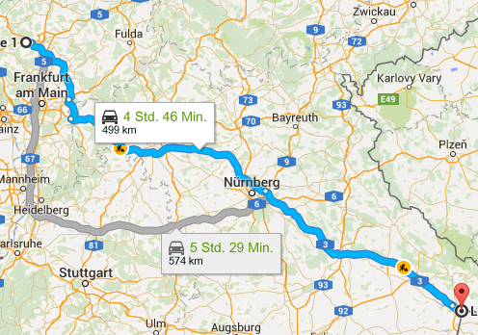
Current situation Getting information for a trip Wetzlar - Passau

Slide 6
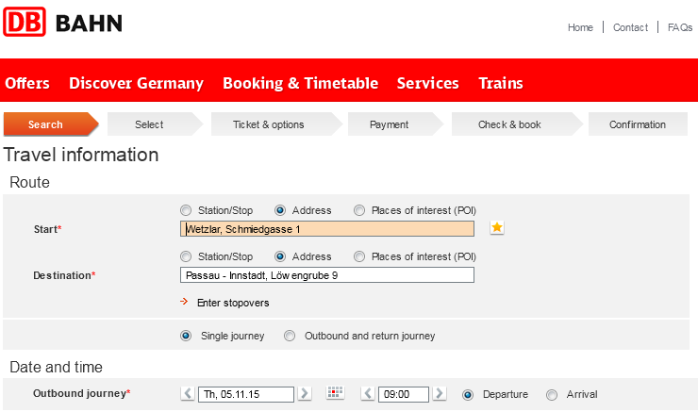
Current situation Getting information for a trip Wetzlar - Passau

Slide 7
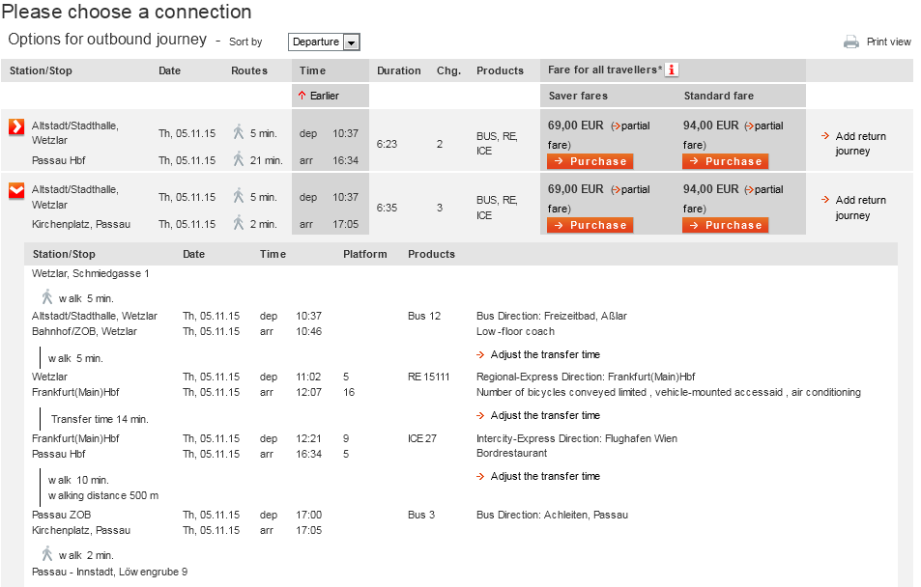
Current situation Getting information for a trip Wetzlar - Passau

Slide 8
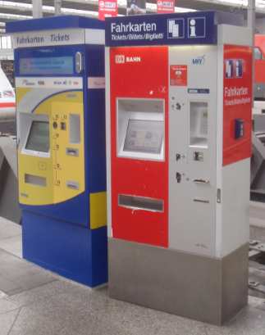
Current situation Information and planning from a customers point
information is mostly available in the home region and own language
long distance travelling even in one country starts to get difficult if the trip is multi modal
in Stockholm I would like to use the tram, but where to buy tickets? The answer is : in the kiosk. How could passengers know?
information in NL about public transport is in Dutch and often in English. Many tourists from Germany, France or Spain do not speak English.
the “foreign credit card syndrome”

Slide 9
Passengers needs Information before the journey
qualified
complete
understandable
useful
free of barriers
consistent
reliable

Slide 10
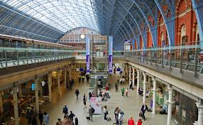
Passengers needs in Information and Ticketing
give a full choice of possible offers
best price
quality of service
flexibility
first choice: one threw-ticket door to door
second choice: all tickets for the whole journey. All tickets together as one single contract, one single point of contact
as an absolutely minimum: full information about the whole journey

Slide 11
Passengers needs during the journey
assistance
for PRM’s
in case of any difficulties
in case of any security problem
information for the next part of the trip
information about rerouting in case of delays, disruptions
customer care and passengers rights irrespective of transport mode and intermodal links

Slide 12
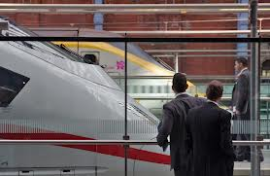
Passengers needs Conclusion
Passengers need to be the core of any thinking and developing for the whole transport industry
even if different stakeholders are competitors, they need to assist any customer to make him happy
reliable and adequate infor- mation is the key element to passengers satisfaction
passengers in the focus has to be daily praxis of any transport undertaking. To put passengers interests into law is only a first step.

Slide 13
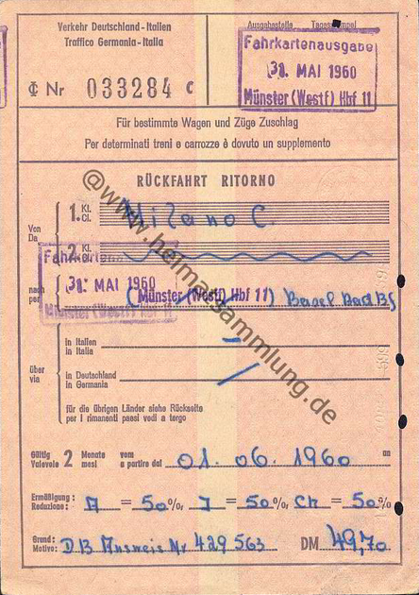
Next steps
the transport sector needs to plan the future
but don’t forget to take the low hanging fruits, don’t wait until technology gives you the solution

Slide 14
Thank you for your attention!

